Slide 1


Data Structures
ETCCDS202
Dr. Aarti
Faculty
School of Engineering & Technology
K.R. Mangalam University
Unit 2 : Linear Data Structures

Slide 2

Unit-2 Linear Data Structures
SESSION 11 Arrays – 1D & 2D
SESSION 12 Static & Dynamic Arrays
SESSION 13 Linked Lists Types
SESSION 14 Linked List Operations
SESSION 15 Stack ADT & Operations
SESSION 16 Stack Applications
SESSION 17 Queue ADT
SESSION 18 Queue Applications
SESSION 19 BFS using Queue
SESSION 20 Revision (Unit–2)
Notes:
New Courses replaced with New Programmes

Slide 3
Linked List Types
Session 13
Introduction to Linked Lists
Why Linked Lists?
Representation of a Linked List
Creation of Node and Declaration of Linked List
Advantages and Disadvantages of Linked Lists
Importance of Linked Lists
Linked List vs Array
Time Complexity Analysis (Linked List vs Array)
Types of Linked Lists
Comparison of Linked List Types
Applications of Linked List Types
Practice Questions
Key Takeaways
Quick Quiz
References
Notes:
New Courses replaced with New Programmes

Slide 4
Learning Objectives
After this lecture, students will be able to:
Define a linked list and explain its basic structure
Describe the need for linked lists over arrays
Explain the representation and creation of nodes in linked lists
Differentiate between singly, doubly, circular, and circular doubly linked lists
Identify advantages and disadvantages of linked lists
Compare linked lists and arrays in terms of performance and memory
Identify suitable applications for each linked list type
Notes:
New Courses replaced with New Programmes

Slide 5
Recapitulation (Static and Dynamic Arrays)
An array is a linear data structure that stores elements of the same data type in contiguous memory locations.
1-D arrays store elements in linear form, while 2-D arrays store data in rows and columns.
Static arrays have a fixed size, allocated at compile time, and are usually stored in stack memory.
Dynamic arrays allow runtime resizing, are stored in heap memory, and provide better memory flexibility.
In Python, lists act as dynamic arrays, automatically resizing when elements are added.
Static arrays are faster but rigid, whereas dynamic arrays are flexible but complex.
Notes:
New Courses replaced with New Programmes

Slide 6
Pretest
Fill in the Blanks
Arrays store elements in __________ memory locations.
The size of a static array is decided at __________ time.
Dynamic arrays are stored in __________ memory.
In Python, a __________ behaves as a dynamic array.
The append() operation in Python lists has __________ time complexity (amortized).
One-Word Answer Questions
Memory used by static arrays
Data structure used to implement dynamic arrays in Python
Type of memory used by dynamic arrays
Notes:
New Courses replaced with New Programmes

Slide 7
Pretest (Answers)
Contiguous
Compile
Heap
List
O(1)
Stack
List
Heap
Notes:
New Courses replaced with New Programmes

Slide 8

Linked List
Source: AI Generated Image
Notes:
New Courses replaced with New Programmes

Slide 9
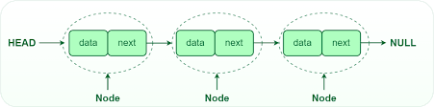
Linked List
Linked list is a linear data structure with series of connected nodes.
Elements are stored in nodes
Each node contains:
Data
Address of next node
A linked list is a linear data structure
The first node is pointed by Head
The last node of the list contains a pointer to the null
https://www.geeksforgeeks.org/what-is-linked-list/
Notes:
New Courses replaced with New Programmes

Slide 10
Why Linked List?
Arrays can be used to store linear data of similar types, but arrays have the following limitations.
The size of the array is fixed:
The size of an array must be known in advance, so the upper limit on the number of elements has to be predefined, and the allocated memory remains equal to this limit regardless of actual usage.
Insertion operation is expensive:
Inserting a new element into an array is costly because space must be created for the new element, which requires shifting existing elements to new positions.
Notes:
New Courses replaced with New Programmes

Slide 11
Example
In a system, if we maintain a sorted list of IDs in an array id[].
id[] = [1000, 1010, 1050, 2000, 2040].
And if we want to insert a new ID 1005, then to maintain the sorted order, we have to move all the elements after 1000 (excluding 1000).
Deletion is also expensive with arrays unless some special techniques are used. For example, to delete 1010 in id[], everything after 1010 has to be moved.
Notes:
New Courses replaced with New Programmes

Slide 12
Representation
A linked list is represented by a pointer to the first node of the linked list.
The first node is called the head. If the linked list is empty, then the value of the head is NULL.
Each node in a list consists of at least two parts:
Data
Pointer (or Reference) to the next node
Notes:
New Courses replaced with New Programmes

Slide 13
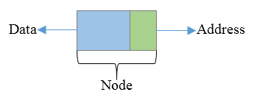
Creation of Node and Declaration of Linked Lists
struct node
{
int data;
struct node * next;
};
struct node * n;
n=(struct node*)malloc(sizeof(struct node*));
Notes:
New Courses replaced with New Programmes

Slide 14

Applications
Source: AI Generated Image
Notes:
New Courses replaced with New Programmes

Slide 15
Advantages And Disadvantages
Advantages
Dynamic data structure
Implementation
Insertion and deletion
Versatility
Persistence
Disadvantages
Memory usage
Accessing an element
More complex implementation
Lack of cache locality
Notes:
New Courses replaced with New Programmes

Slide 16
Importance of Linked List
Dynamic Data structure
Ease of Insertion/Deletion.
Efficient Memory Utilization
Implementation
Notes:
New Courses replaced with New Programmes

Slide 17
Linked List vs Array
Array | Linked List
Arrays are stored in contiguous location. | Linked Lists are not stored in contiguous location.
Fixed size. | Dynamic Size
Memory is allocated at compile time. | Memory is allocated at run time.
Uses less memory than Linked Lists. | Uses more memory than Arrays as it stores both data and address of next node.
Elements can be accessed easily in O(1) time. | Elements can be access by traversing through all the nodes till we reach the required node.
Insertion and deletion operation is slower than Linked List. | Insertion and deletion operation is faster than Linked List.
Notes:
New Courses replaced with New Programmes

Slide 18
Time Complexity Analysis of Linked List and Array
Operation | Linked list | Array
Random Access | O(N) | O(1)
Insertion and deletion at beginning | O(1) | O(N)
Insertion and deletion at end | O(N) | O(1)
Insertion and deletion at a random position | O(N) | O(N)
Notes:
New Courses replaced with New Programmes

Slide 19
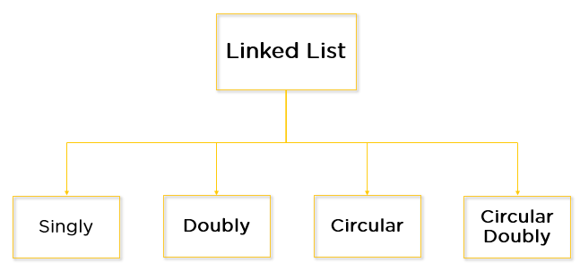
Types of linked list
Notes:
New Courses replaced with New Programmes

Slide 20
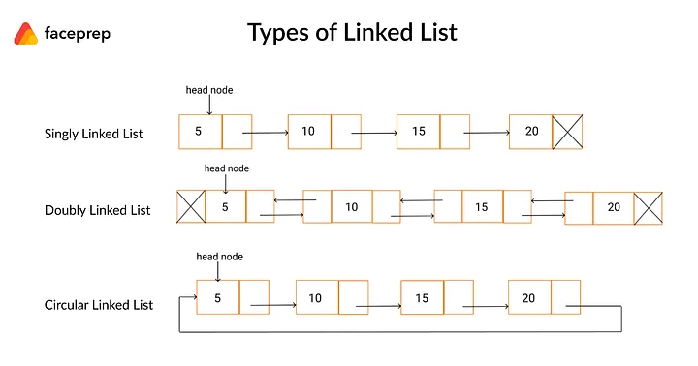
Singly Linked List
A Singly Linked List is a linked list in which:
Each node contains one pointer
Pointer points to the next node
Last node points to NULL
Singly Linked List – Node Structure:
Data field
Next pointer
Notes:
New Courses replaced with New Programmes

Slide 21
Singly Linked List- Key Features
One-directional traversal
Less memory usage
Simple implementation
Traversal possible only in forward direction
Notes:
New Courses replaced with New Programmes

Slide 22
Check Your Understanding
❓ How many pointers does a node have in a singly linked list? ❓ What does the last node point to?
Notes:
New Courses replaced with New Programmes

Slide 23
Check Your Understanding (Answers)
❓ How many pointers does a node have in a singly linked list?
A node in a singly linked list has one pointer.
❓ What does the last node point to?
The last node points to NULL.
Notes:
New Courses replaced with New Programmes

Slide 24
Doubly Linked List
A Doubly Linked List is a linked list in which:
Each node contains two pointers
One points to the previous node
One points to the next node
Node Structure:
Previous pointer
Data field
Next pointer
Notes:
New Courses replaced with New Programmes

Slide 25
Doubly Linked List – Key Features
Bidirectional traversal
Easier deletion
Requires more memory
Extra pointer increases memory overhead
Notes:
New Courses replaced with New Programmes

Slide 26
Check Your Understanding (Answers)
❓ How many pointers are present in a doubly linked list node? A doubly linked list node has two pointers (previous and next).
❓ Can traversal happen in both directions?
Yes, traversal can happen in both forward and backward directions
Notes:
New Courses replaced with New Programmes

Slide 27
Circular Linked List
A Circular Linked List is a linked list in which:
The last node does not point to NULL
It points back to the first node (head)
Circular Linked List – Representation
Note: No NULL pointer in the list
Notes:
New Courses replaced with New Programmes

Slide 28
Circular Linked List- Key Features
Continuous traversal possible
No NULL pointers
Useful for cyclic operations
Notes:
New Courses replaced with New Programmes

Slide 29
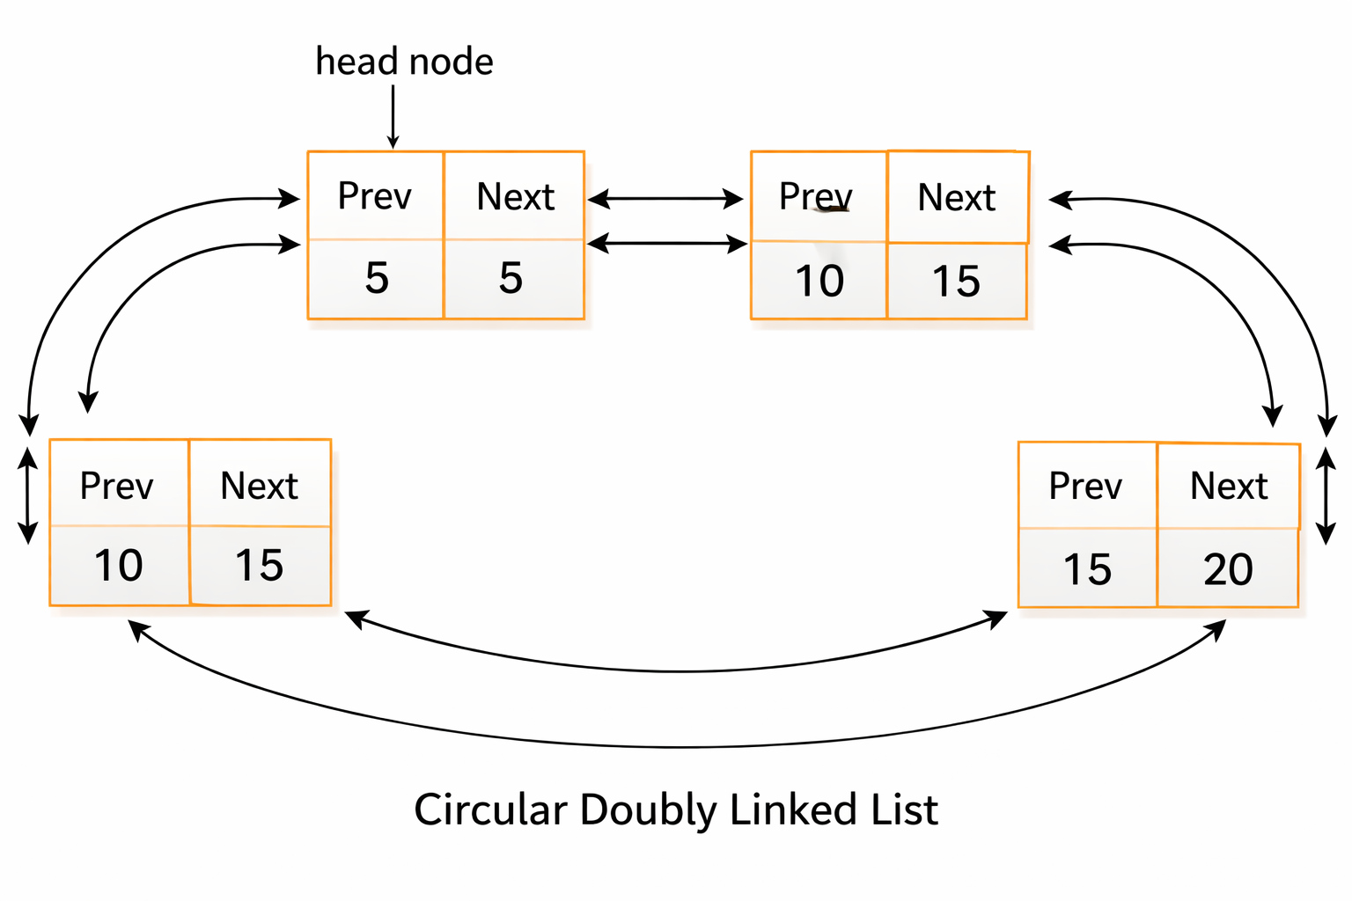
Circular Doubly Linked List
Combines features of doubly and circular linked lists
Last node points to first
First node points to last
Circular Doubly Linked List – Structure
Notes:
New Courses replaced with New Programmes

Slide 30
Comparison of Linked List Types
Feature | Singly LL | Doubly LL | Circular LL
Pointers per node | 1 | 2 | 1 / 2
Traversal | One-way | Two-way | Circular
Memory usage | Low | High | Medium
NULL pointer | Yes | Yes | No
Notes:
New Courses replaced with New Programmes

Slide 31
Applications of Linked List Types
Singly Linked List: Music playlists
Doubly Linked List: Browser back & forward navigation
Circular Linked List: CPU scheduling
Circular Doubly Linked List: Multiplayer games, navigation systems
Notes:
New Courses replaced with New Programmes

Slide 32
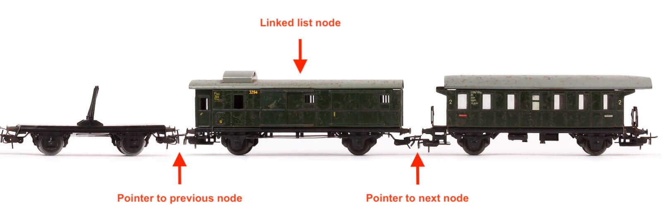
Identify the type of Linked List
Notes:
New Courses replaced with New Programmes

Slide 33
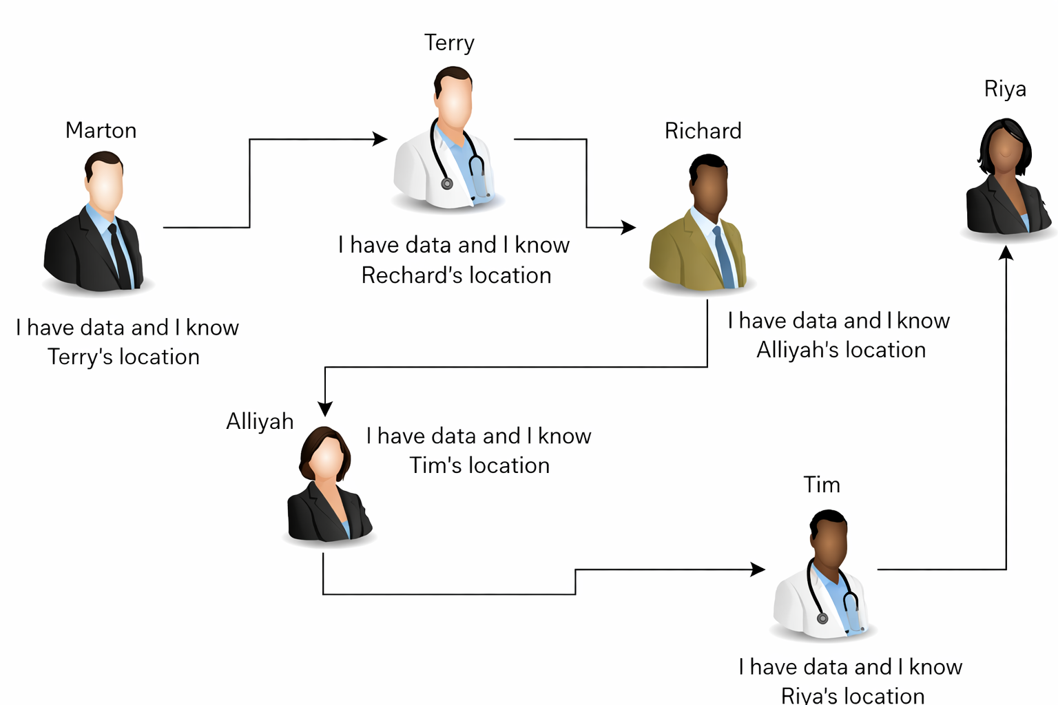
Identify the type of Linked List
Notes:
New Courses replaced with New Programmes

Slide 34
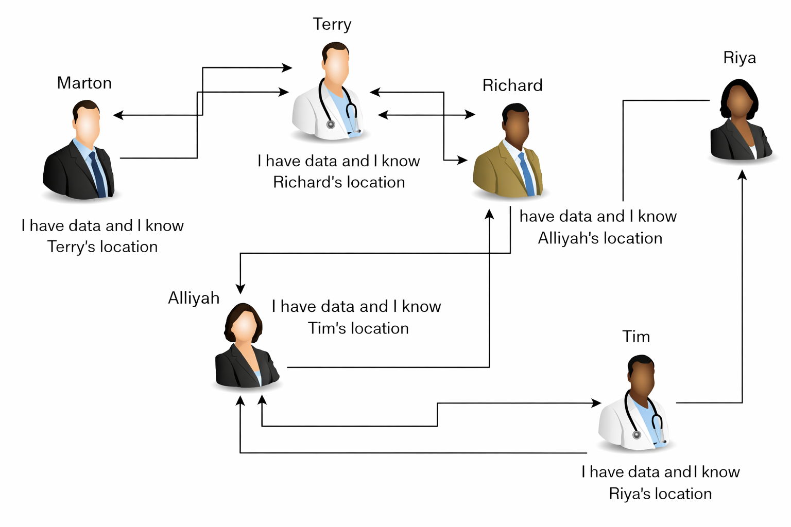
Identify the type of Linked List
Notes:
New Courses replaced with New Programmes

Slide 35

Identify the type of Linked List
Notes:
New Courses replaced with New Programmes

Slide 36
Practice Question
Write node structure for each linked list type
Notes:
New Courses replaced with New Programmes

Slide 37
Practice Questions (Answer)
Write node structure for each linked list type
1️⃣ Singly Linked List – Node Structure | 2️⃣ Doubly Linked List – Node Structure | 3️⃣ Circular Singly Linked List – Node Structure | 4️⃣ Circular Doubly Linked List – Node Structure
struct Node { int data; struct Node* next; }; 📌 Explanation: Each node contains data and a single pointer next that points to the next node in the list. | struct Node { int data; struct Node* prev; struct Node* next; }; 📌 Explanation: Each node contains data, a pointer to the previous node, and a pointer to the next node. | struct Node { int data; struct Node* next; }; 📌 Explanation: The node structure is the same as a singly linked list, but the last node’s next pointer points to the head instead of NULL. | struct Node { int data; struct Node* prev; struct Node* next; }; 📌 Explanation: Each node has two pointers, and the list is circular— next of last node → head prev of head → last node
Notes:
New Courses replaced with New Programmes

Slide 38
Practice Questions (Answer)
Write node structure for each linked list type (Python)
1️⃣ Singly Linked List – Node Structure | 2️⃣ Doubly Linked List – Node Structure | 3️⃣ Circular Singly Linked List – Node Structure | 4️⃣ Circular Doubly Linked List – Node Structure
class Node: def __init__(self, data): self.data = data self.next = None 📌 Each node stores data and a reference to the next node. | class Node: def __init__(self, data): self.data = data self.prev = None self.next = None 📌 Each node stores data, a reference to the previous node, and a reference to the next node. | class Node: def __init__(self, data): self.data = data self.next = None 📌 Structure is the same as singly linked list, but the last node’s next points to the head. | class Node: def __init__(self, data): self.data = data self.prev = None self.next = None 📌 Structure is the same as doubly linked list, but: next of last node → head prev of head → last node
Notes:
New Courses replaced with New Programmes

Slide 39
Key Takeaways
Linked lists use pointers to connect nodes
Different types exist based on pointer usage
Singly LL is memory efficient
Doubly LL allows backward traversal
Circular LL avoids NULL pointers
Notes:
New Courses replaced with New Programmes

Slide 40
Quick Quiz
Which linked list supports backward traversal?
Which linked list has no NULL pointer?
Which linked list uses the least memory?
Notes:
New Courses replaced with New Programmes

Slide 41
Quick Quiz (Answers)
Which linked list supports backward traversal? Doubly linked list supports backward traversal.
Which linked list has no NULL pointer? Circular linked list has no NULL pointer.
Which linked list uses the least memory? Singly linked list uses the least memory.
Notes:
New Courses replaced with New Programmes

Slide 42
Test Your self
1. As we have the memory address of nodes, can we traverse backwards in a linked list?
2. What are the advantages of a linked list?
a: Dynamic Memory Allocation
b: They require less memory than an array to store the same data.
c: We can easily traverse back to previous elements.
d: None of the above.
3. What is the time complexity for the insertion of an element into a linked list?
Notes:
New Courses replaced with New Programmes

Slide 43
Quiz Answers
Answer: No, we can’t.
Answer :a
Answer : O(n)
https://questions.examside.com/past-years/gate/question/pconsider-the-problem-of-reversing-a-singly-linked-list-t-gate-cse-theory-of-computation-finite-automata-and-regular-language-zpfpkf4re1g8xuff
Notes:
New Courses replaced with New Programmes

Slide 44
References
Textbooks
Cormen, T. H., Leiserson, C. E., Rivest, R. L., & Stein, C., Introduction to Algorithms, MIT Press.
Lipschutz, S., Schaum’s Outline of Data Structures with C++, McGraw-Hill Education.
Reference Books
Weiss, M. A., Data Structures and Algorithm Analysis in C++, 5th Edition, Pearson Education.
Skiena, S. S., The Algorithm Design Manual, 3rd Edition, Springer.
Online Resources
GeeksforGeeks – Linked List Introduction https://www.geeksforgeeks.org/what-is-linked-list/
GeeksforGeeks – Types of Linked Lists https://www.geeksforgeeks.org/types-of-linked-list/
TutorialsPoint – Data Structures: Linked List https://www.tutorialspoint.com/data_structures_algorithms/linked_list_algorithms.htm
MIT OpenCourseWare – Introduction to Algorithms https://ocw.mit.edu
Programiz – Linked List in Python https://www.programiz.com/dsa/linked-list
Notes:
New Courses replaced with New Programmes

Slide 45
THANK YOU

